Slide 1
Team & Group
Module - III

Slide 2
Group can be defined as
A collection of two or more interacting individuals with a stable pattern of relationship between them and share common goal.
Three characteristics of group:
1. interaction among group
2. Common interest or goal
3. People see themselves as members

Slide 3
Why we / people join in group?
People join group is related to our needs:
Close proximity (frequent interaction influence the behaviour on one another).
security (support and guidance)
Esteem ( through group membership)
Affiliation (share common hobbies or common backgrounds) (it happens with new join employees in an organisation)
Power (united we stand, divided we fall)
identity (image)
task function. (helpful in large organisation) (complex task, generating new ideas)

Slide 4
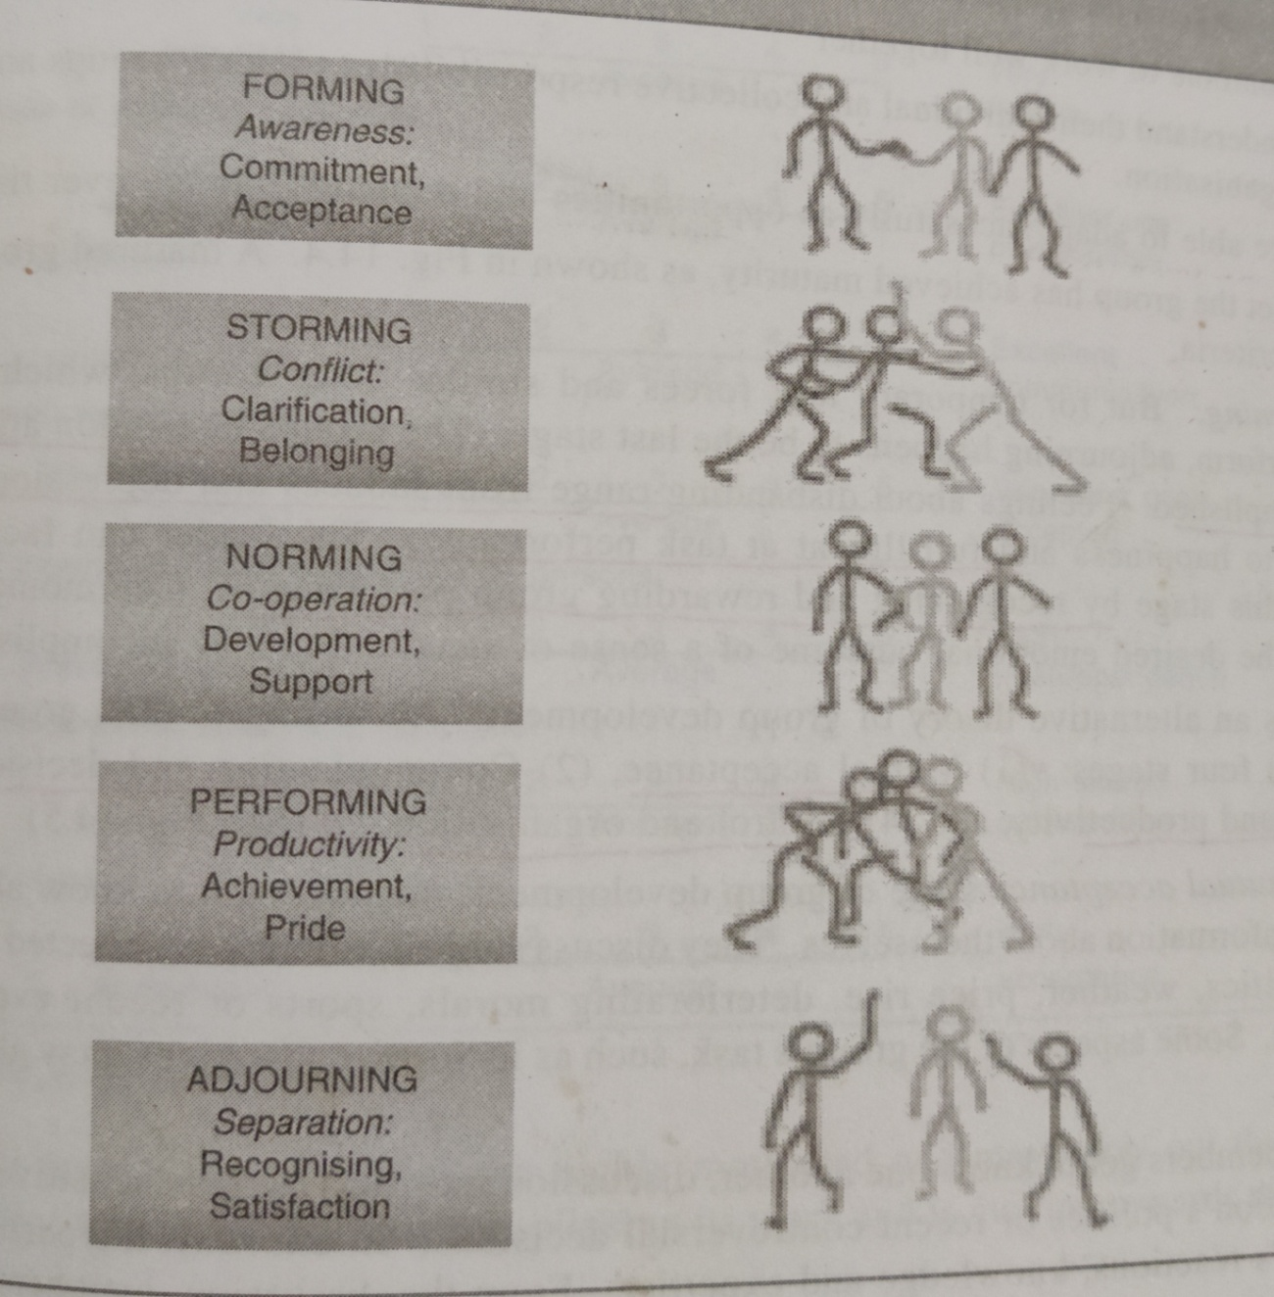
Group Development ( stages of group formation)

Slide 5
Elaboration of stages of group formation
Forming:
In this stage , there is a great deal of uncertainty about people's purpose, structure, leadership.
Not sure about the behaviours of each other.
Here , icebreaking is essential to increase awareness among each other.
Here , the development occurs when members accept themselves and decide a group goal.

Slide 6
Elaboration of stages of group formation
Storming :
Here, conflict arises because of the need to clarify roles and behavioural expectations.
Disagreement relating to role assignments.
One objective in this stage is to resolve conflict about power and task structure.
Replace the member who are not adjustable in the group with sense of acceptance.

Slide 7
Elaboration of stages of group formation
Norming:
At this stage, a single leader emerges, who will bring cohesion.
Here sense of strong identity developed.
Member involvement increase as they get mental support.
Performing:
This stage is marked by teamwork, role clarity and task accomplishment.
Productivity is at peak.
Continue to work well together
Able to adapt the change successfully.

Slide 8
Elaboration of stages of group formation
Adjourning:
If the group has to de a specific task, then complete of task they need to separate..
Reward will given to keep the pleasurable momentum among group members, as they feel sad.

Slide 9
Group norms
These are set of beliefs, feelings and attitudes commonly shared by group members. These are also referred to as rules or standards of behaviour that apply to group members.
Norms serve three functions in the group:
1. predictive (understand the behaviour of others and own)
2. control (regulate the behaviour of members)
3. relational (define relationship among roles)

Slide 10
Why norms strongly enforced in group?
To ensure group performance
To avoid the preference of supervisors towards group members
To predict the behaviour of group members while performing task to avoid interpersonal problems.

Slide 11
Group cohesiveness
It refers to the extent of linking each member has towards others and how far everyone wants to remain as a member of group.
Group cohesiveness can be affected by such factors as interaction, threat, cooperation, similarity attitude, and size.
Positive consequences:
Increased moral, higher productivity, better communication
Negative consequences:
Lower productivity when group will have lower norms.

Slide 12
Introduction to Teams
A team is a group of individuals with complementary skills working towards a shared goal.
Example: A product development team including engineers, designers, and marketers.
Teams foster collaboration, responsibility, and goal alignment.

Slide 13
Why Work Teams?
Synergy: Teams produce better outcomes together than individuals alone.
Example: Hospital care teams combine doctors, nurses, and technicians for better patient outcomes.
Innovation: Diverse members contribute fresh ideas.
Ownership: Shared goals increase accountability and motivation.
Flexibility: Teams adapt quickly to change.
Better Decisions: Multiple perspectives improve judgment and results.

Slide 14
Types of Work Teams
Problem-Solving Teams: Meet regularly to improve work processes (e.g., quality circles in manufacturing).
Self-Managed Teams: Plan and manage work independently (e.g., agile software teams).
Cross-Functional Teams: Members from different areas work on a project (e.g., product launch team).
Virtual Teams: Collaborate online from different locations (e.g., remote tech support teams).

Slide 15
Developing Work Teams
Forming: Team members meet and understand tasks (e.g., orientation).
Storming: Conflicts may arise; roles are clarified.
Norming: Norms are established; trust builds.
Performing: Team operates efficiently toward goals.
Adjourning: Task completed, team disbands (e.g., event management teams' post-event).

Slide 16
Team Effectiveness
Clear Goals: Shared understanding of purpose.
Defined Roles: Everyone knows their responsibilities.
Trust & Communication: Open, honest dialogue.
Leadership: Effective guidance and support.
Resources & Feedback: Tools and performance insights available.
Example: High-performing sales teams have clear targets and communicate regularly.

Slide 17
Team Building
Purpose: Strengthen collaboration, trust, and motivation.
Activities: Ice-breakers, problem-solving games, retreats.
Example: A startup holds a team-building weekend to boost morale and coordination.
Helps align team members and resolve interpersonal conflicts.

